Slide 1
University Management System
MD. DINIL ISLAM
ID:153402326

Slide 2
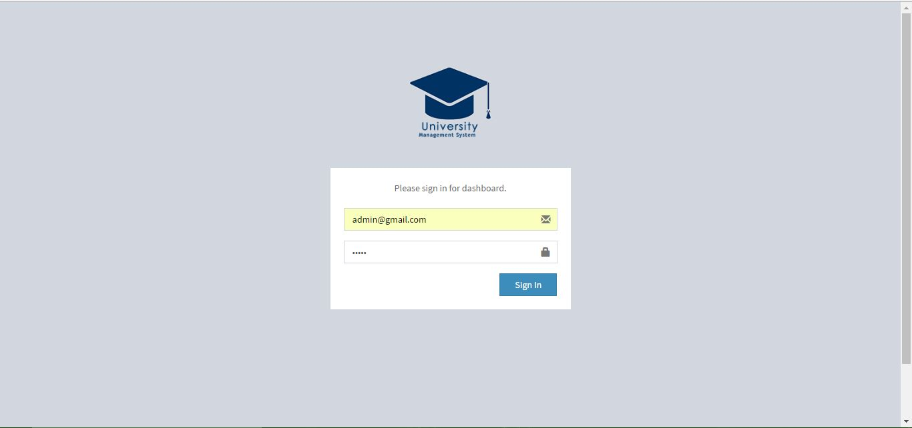
Login Page

Slide 3
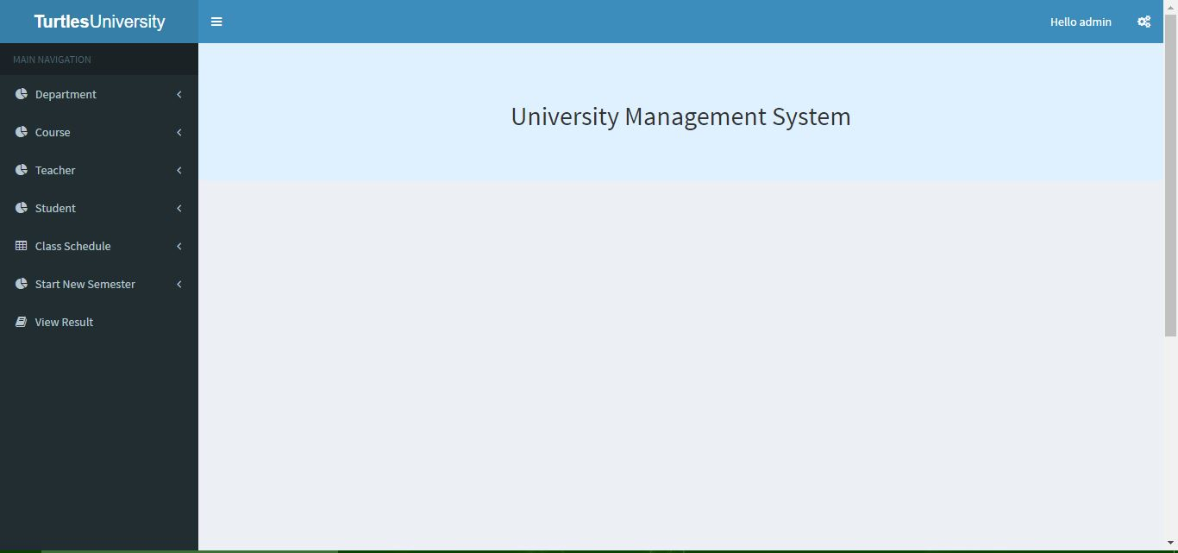
Home Page

Slide 4
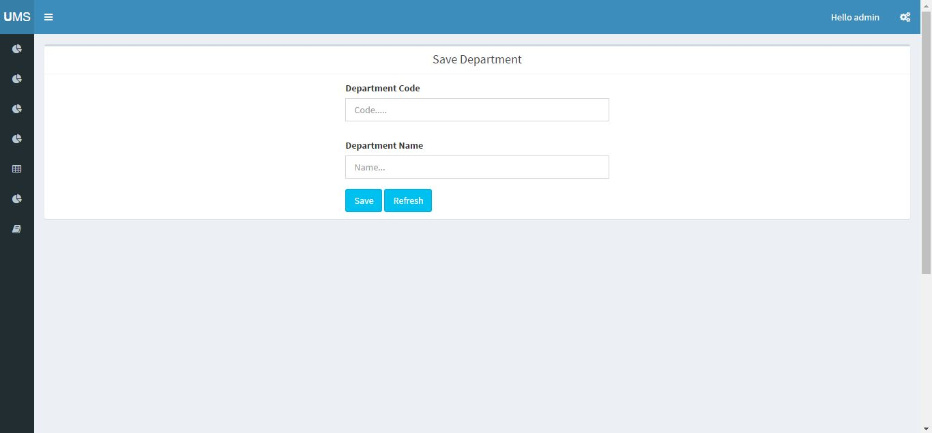
Creat Department

Slide 5
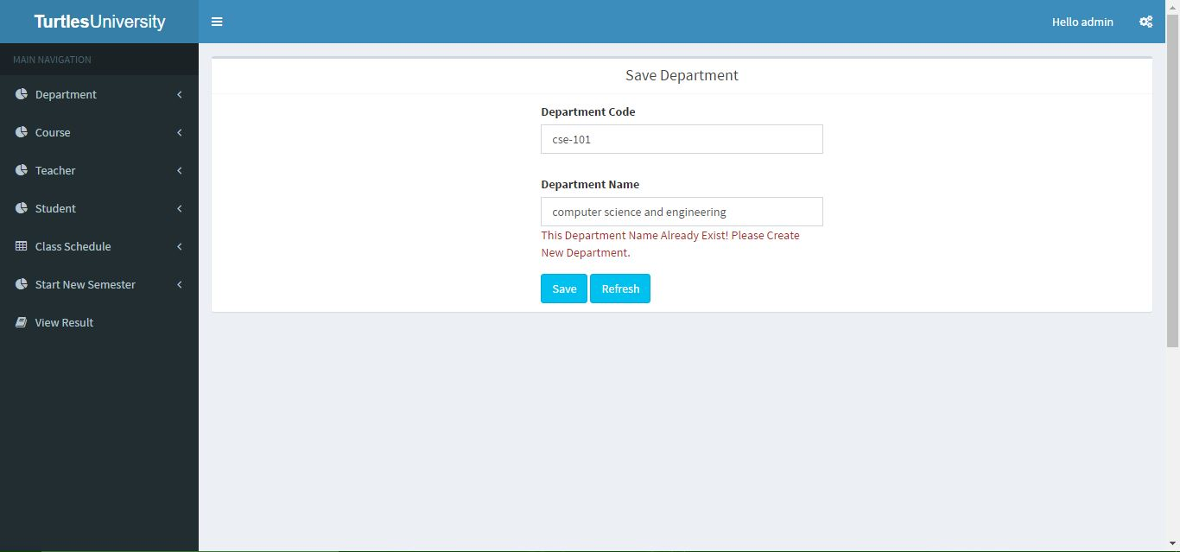
If Department Exist

Slide 6

New Department

Slide 7
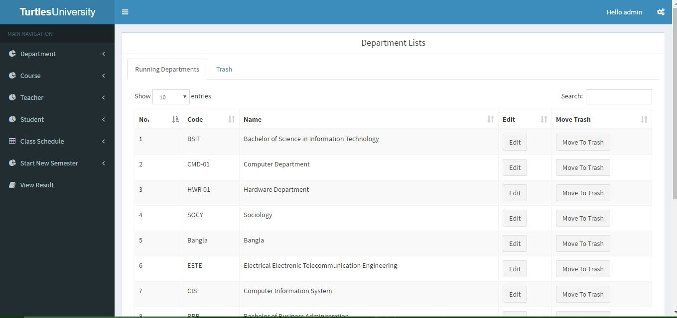
Department List

Slide 8
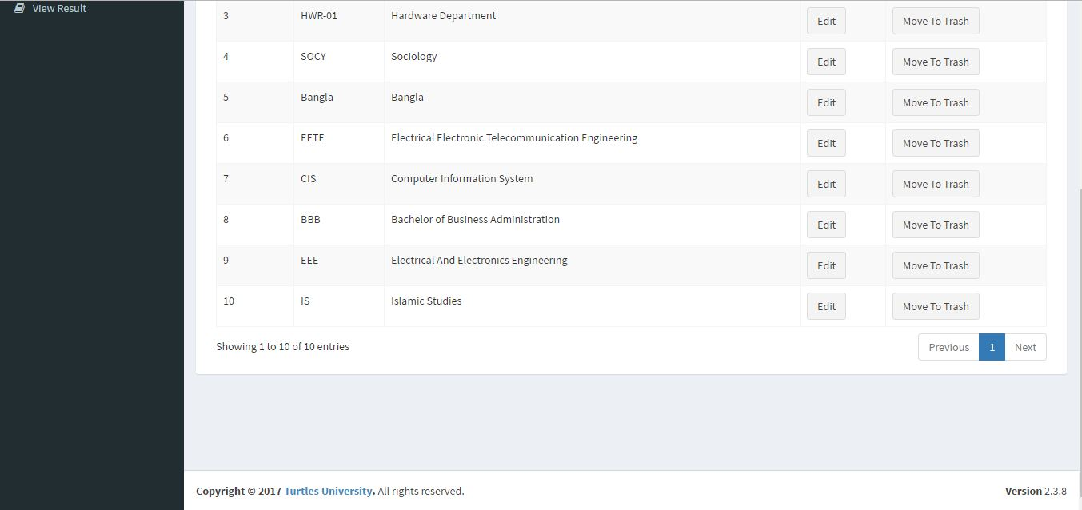
Department List

Slide 9
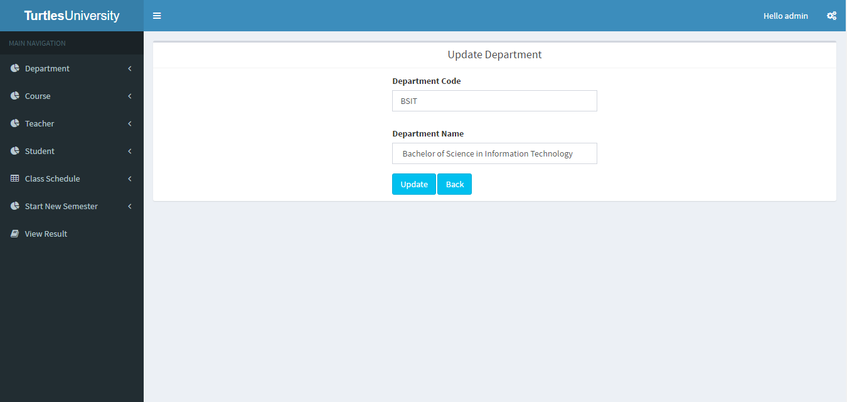
Update department

Slide 10
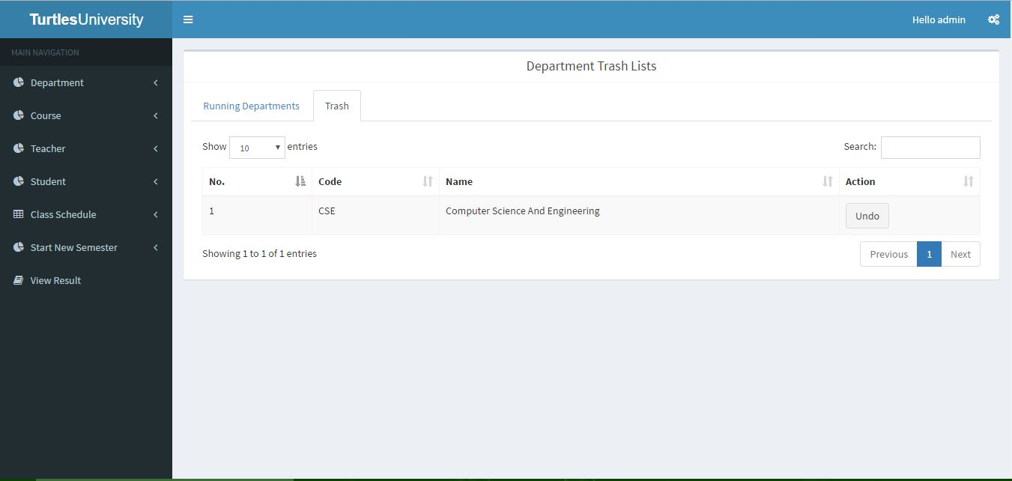
Department List Trash

Slide 11
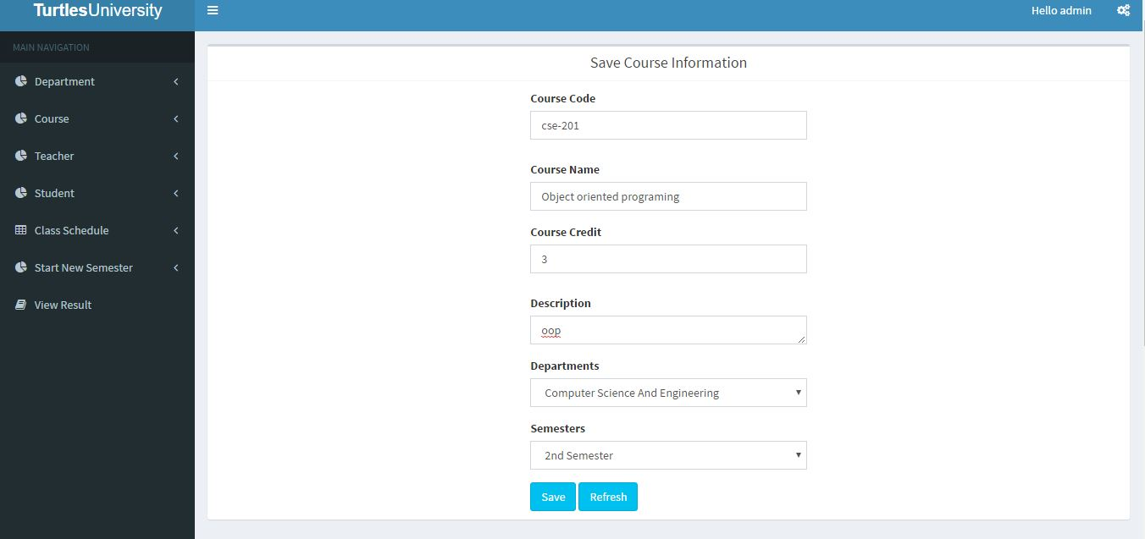
Creat New Course

Slide 12
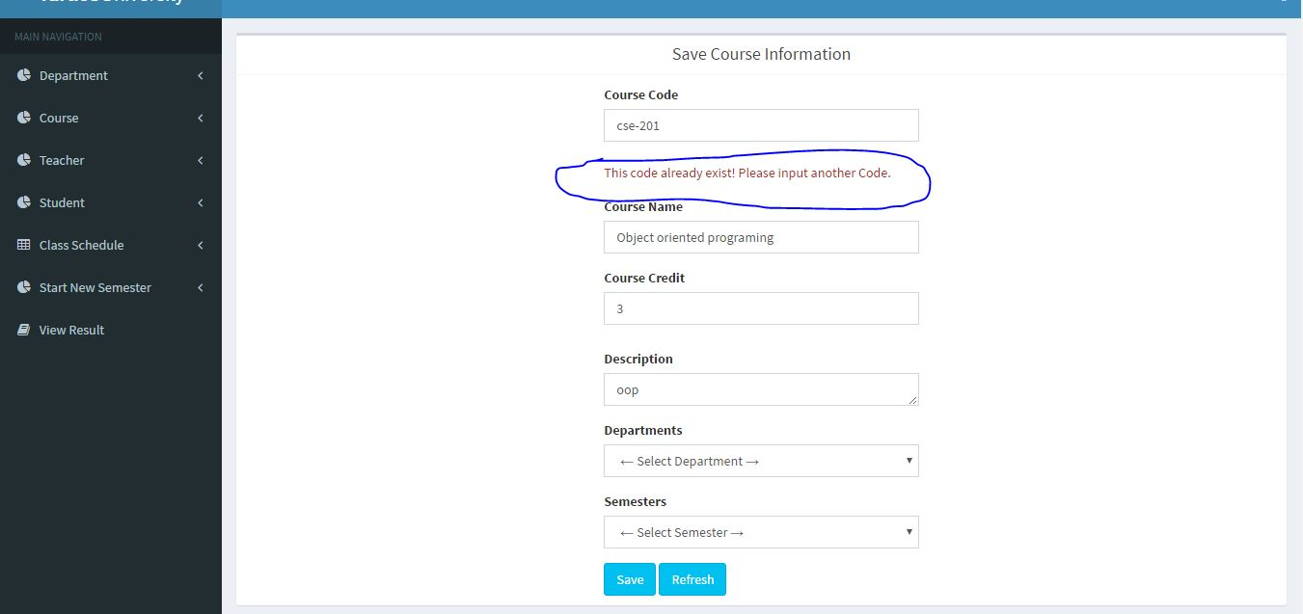
If course Already Exist

Slide 13
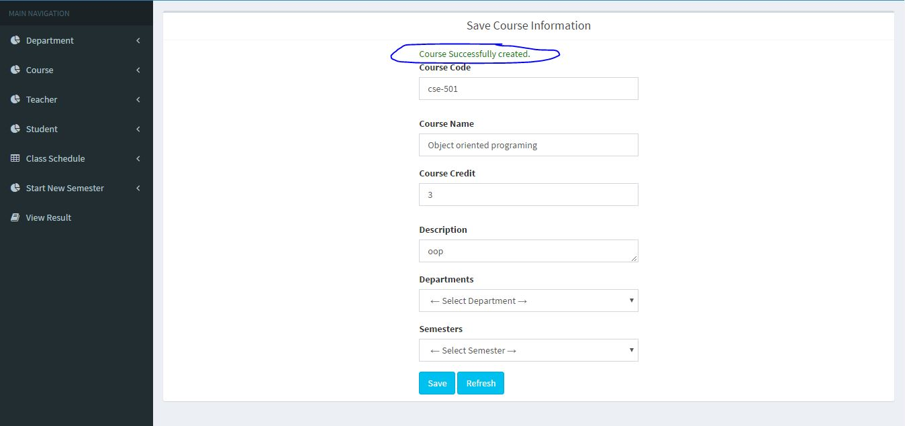
Course Successfully Created

Slide 14
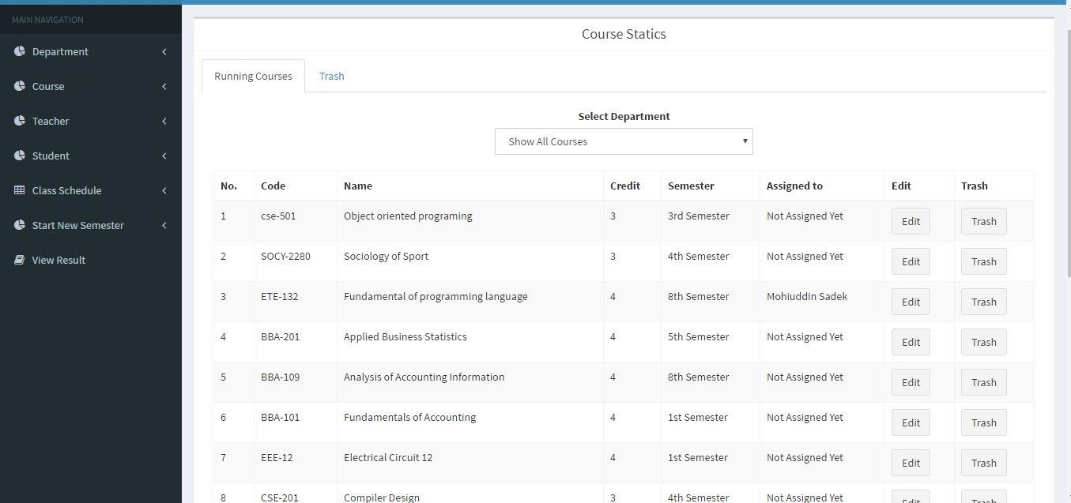
Course List

Slide 15
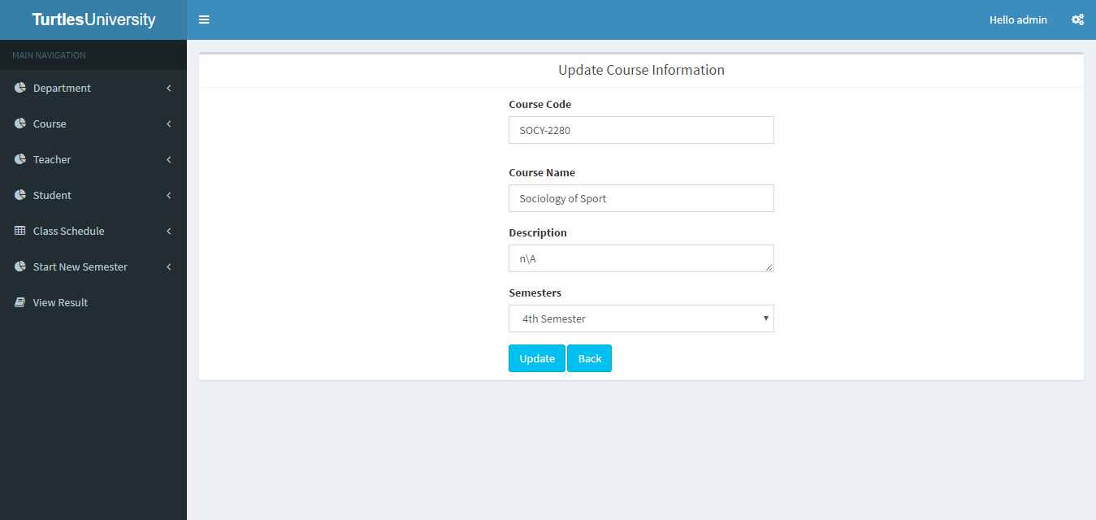
Update course information

Slide 16

Course trash list

Slide 17
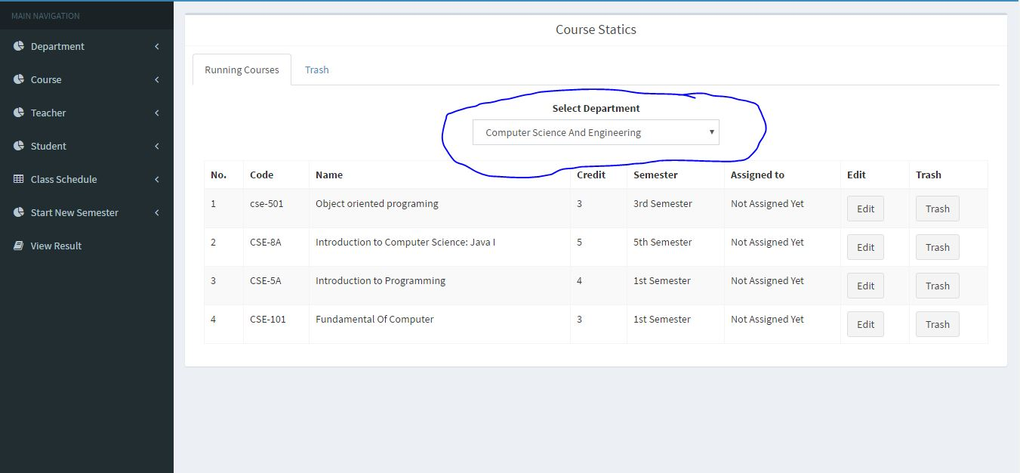
You can select the Dept. to see the courses

Slide 18
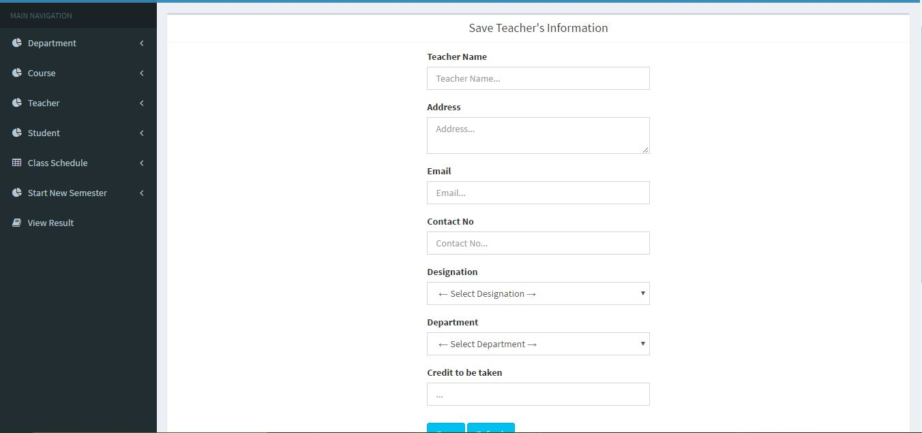
Add new Teacher

Slide 19
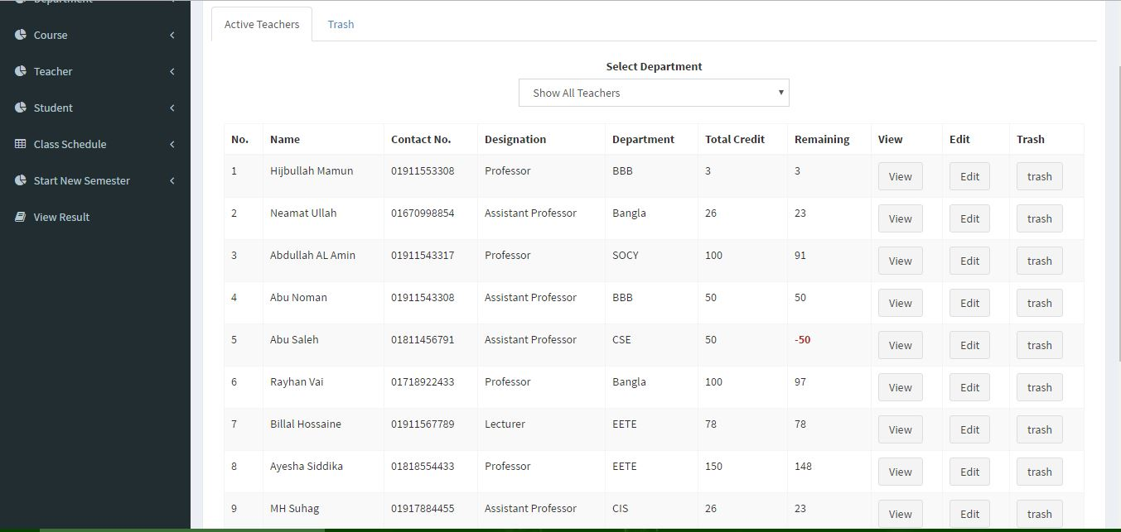
Teachers list

Slide 20
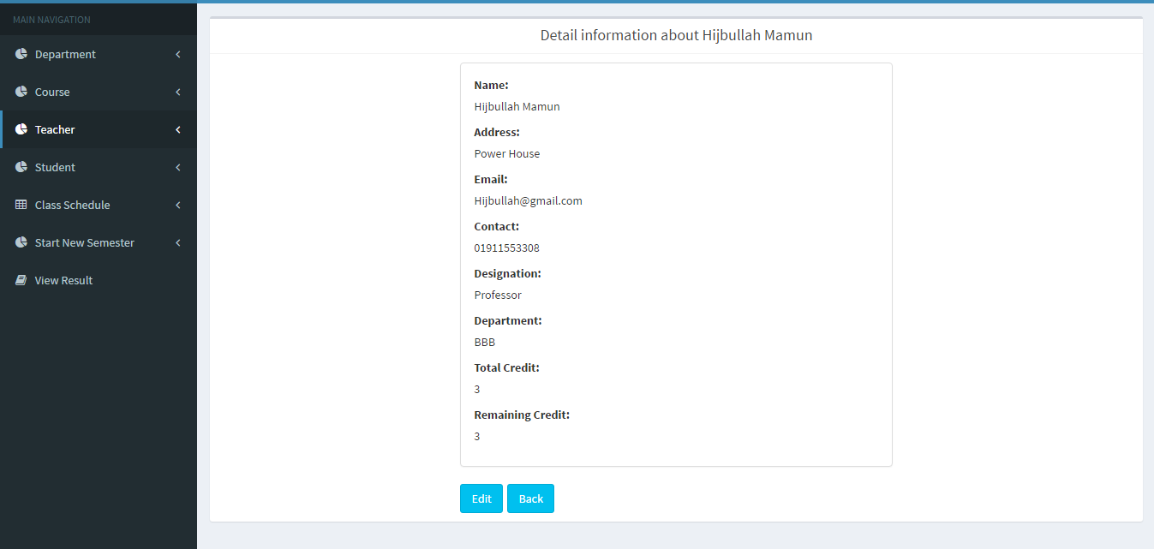
Detail Information of a teacher

Slide 21

Update teachers informatoin

Slide 22

Teachers trash list

Slide 23
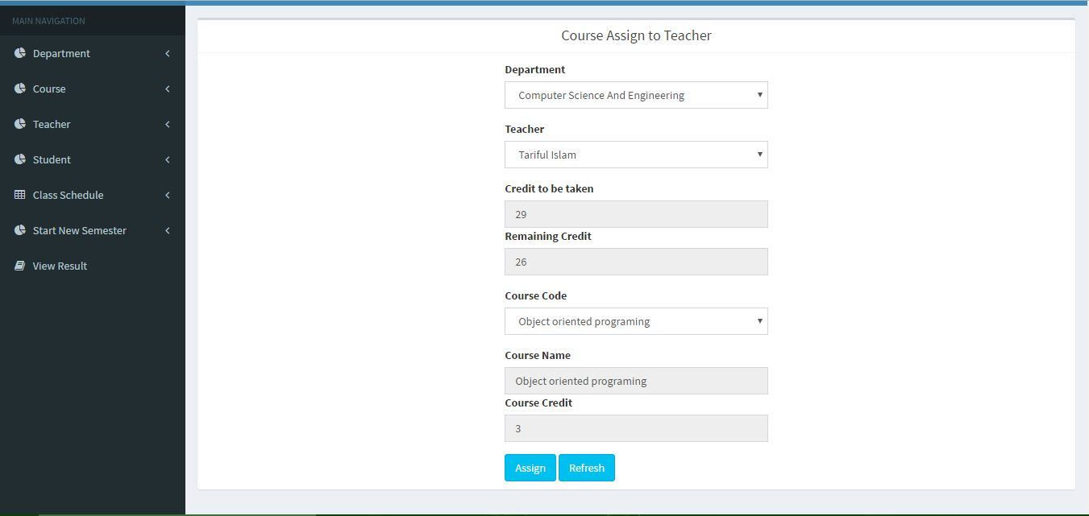
Assign course to a Teacher

Slide 24
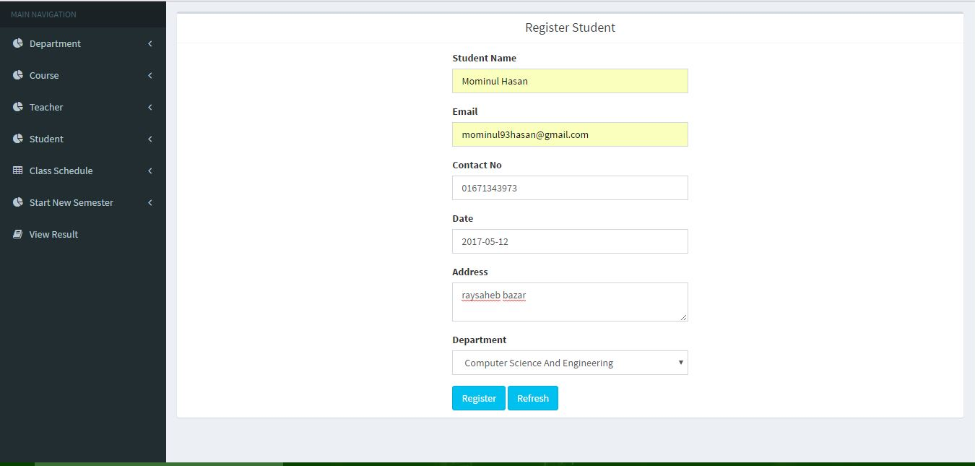
Register Student

Slide 25
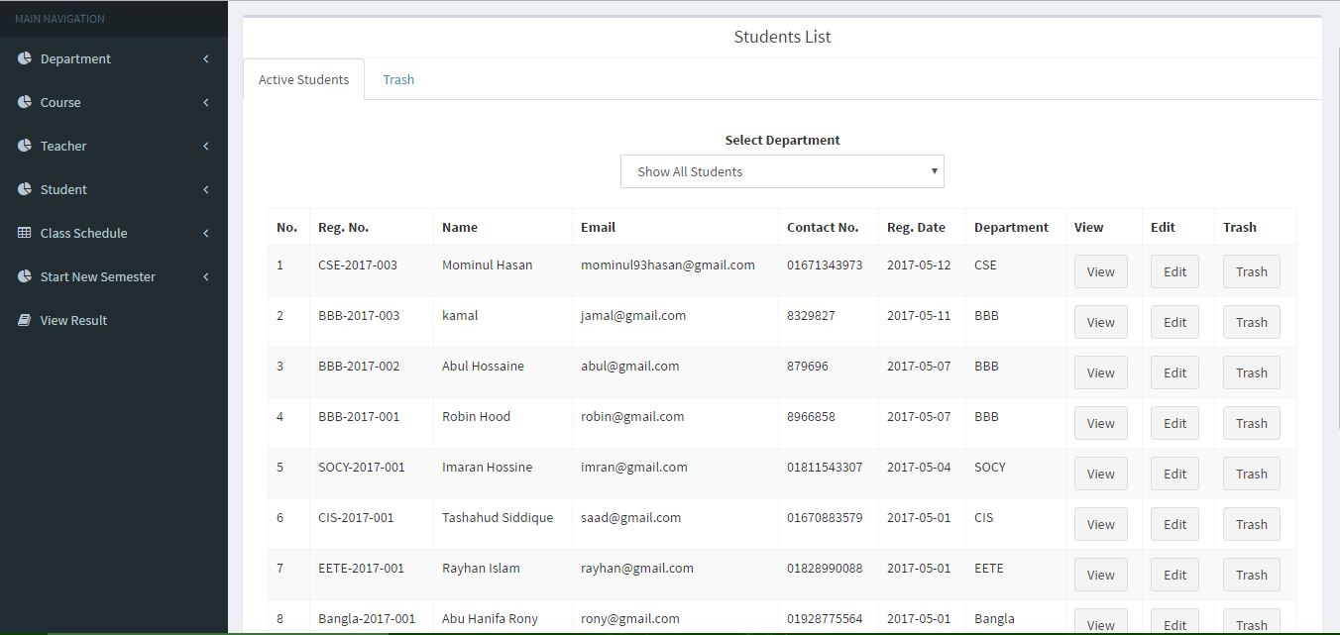
Student list

Slide 26
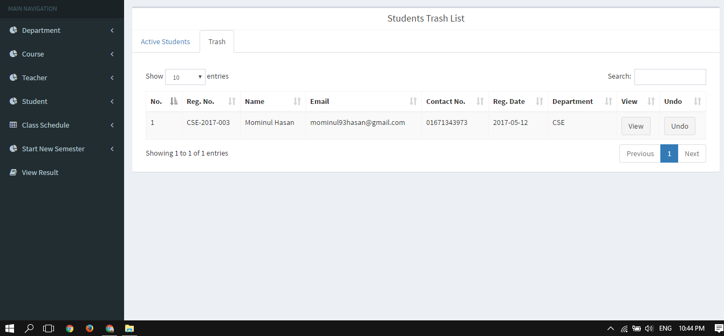
Student trash list

Slide 27
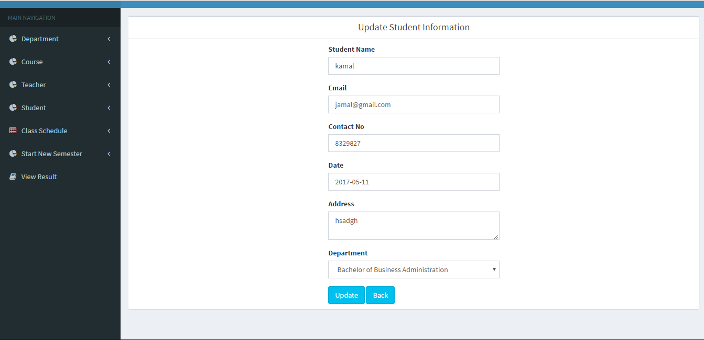
Update student information

Slide 28
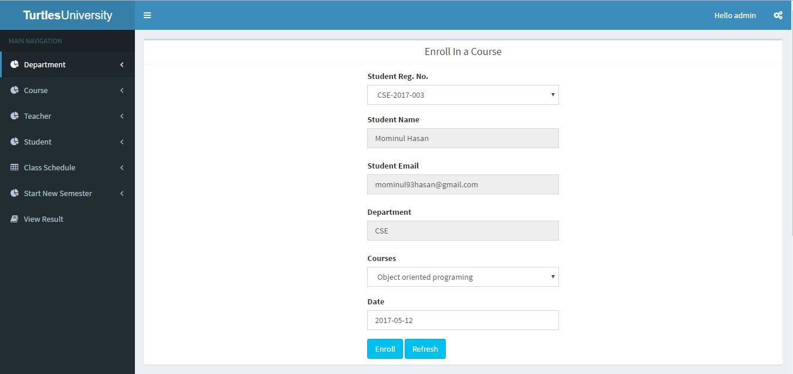
Enroll in a course

Slide 29
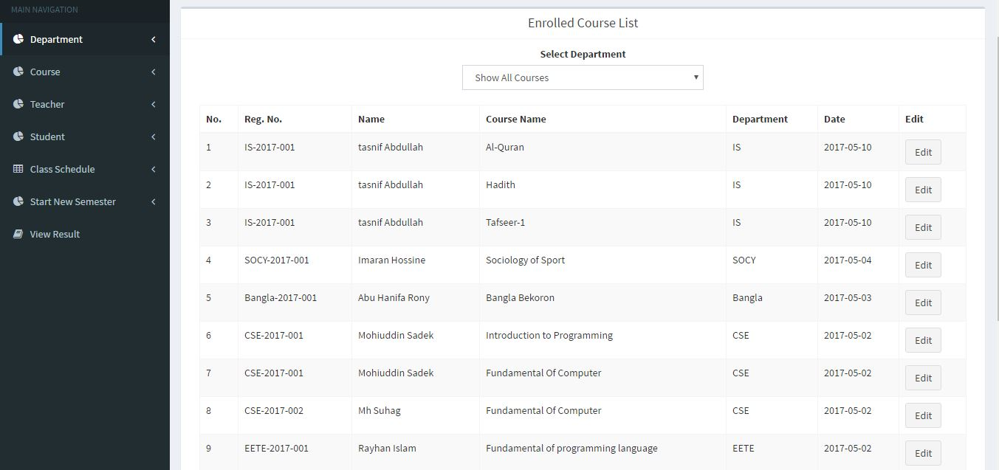
Enrolled course list

Slide 30
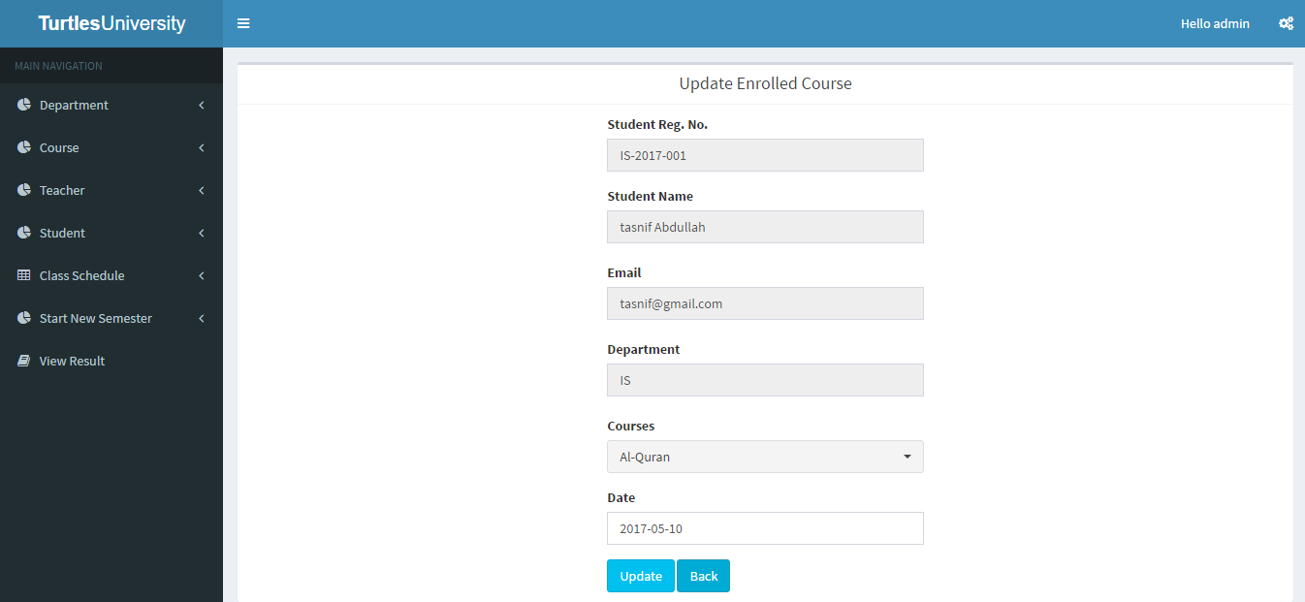
Update enrolled courses

Slide 31

Creat student result

Slide 32
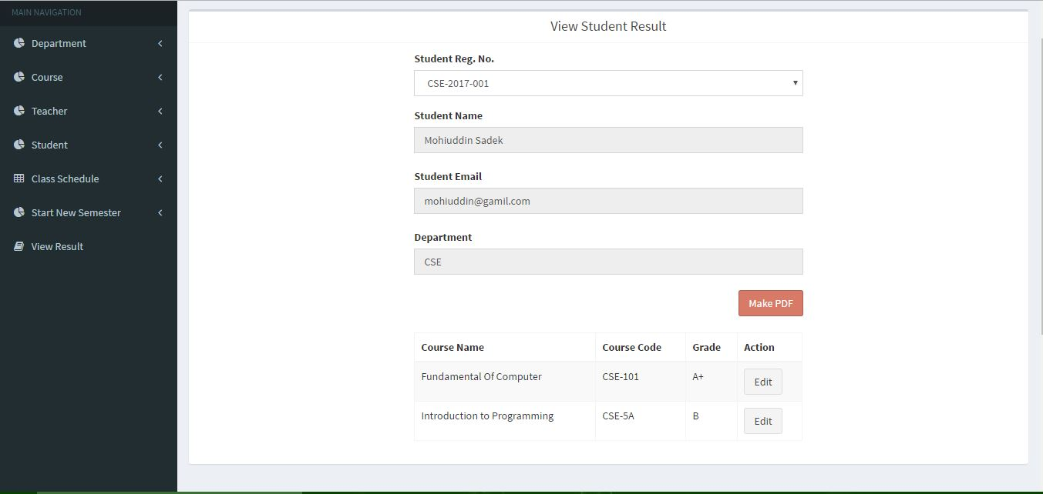
View student result

Slide 33

Result update

Slide 34
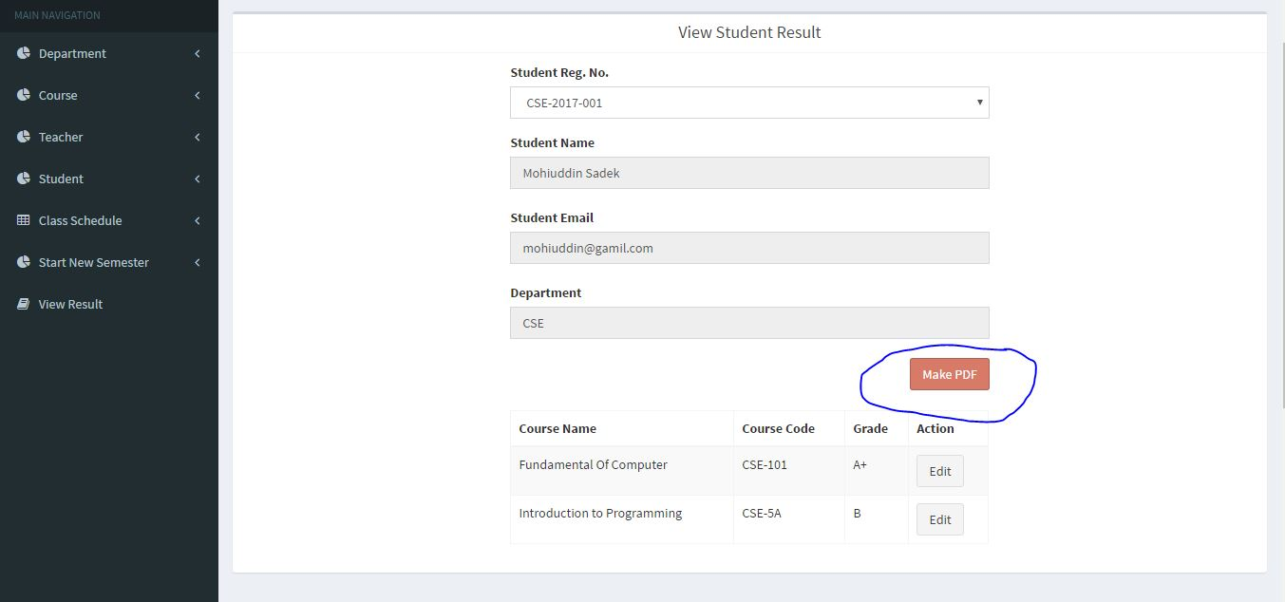
Making PDF of student result

Slide 35
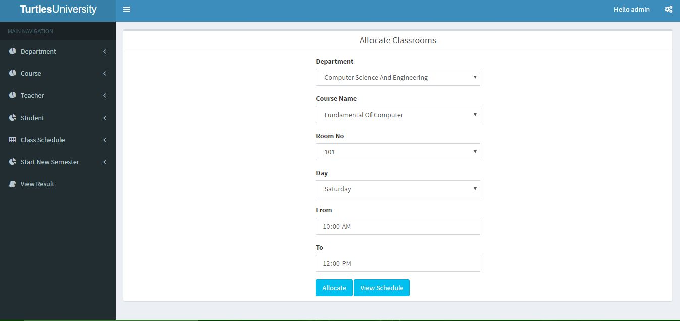
Allocate Classrom

Slide 36
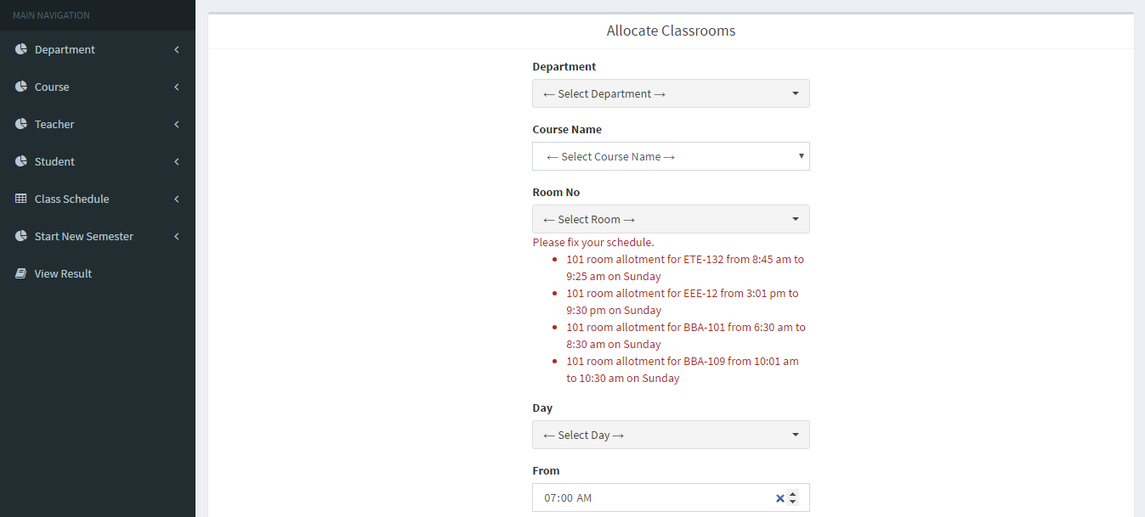
Allocate classroom

Slide 37
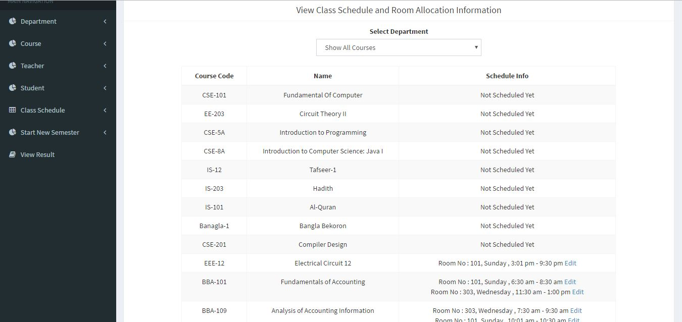
View Class Schedule and Room Allocation Information

Slide 38
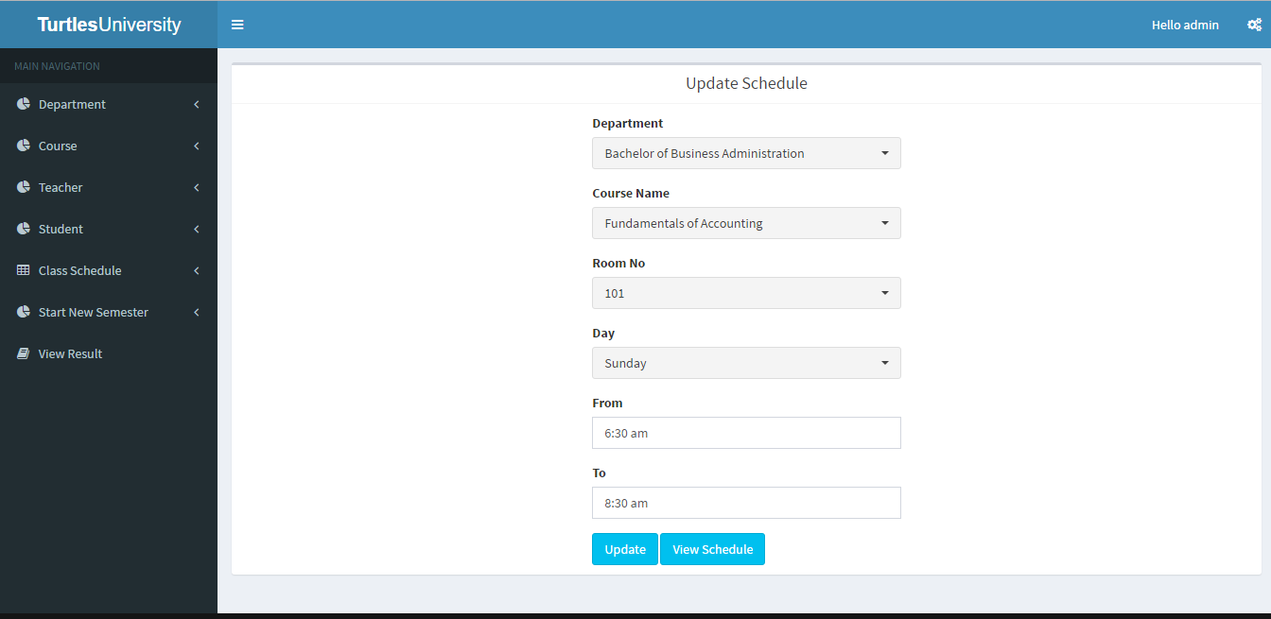
Update schedule

Slide 39
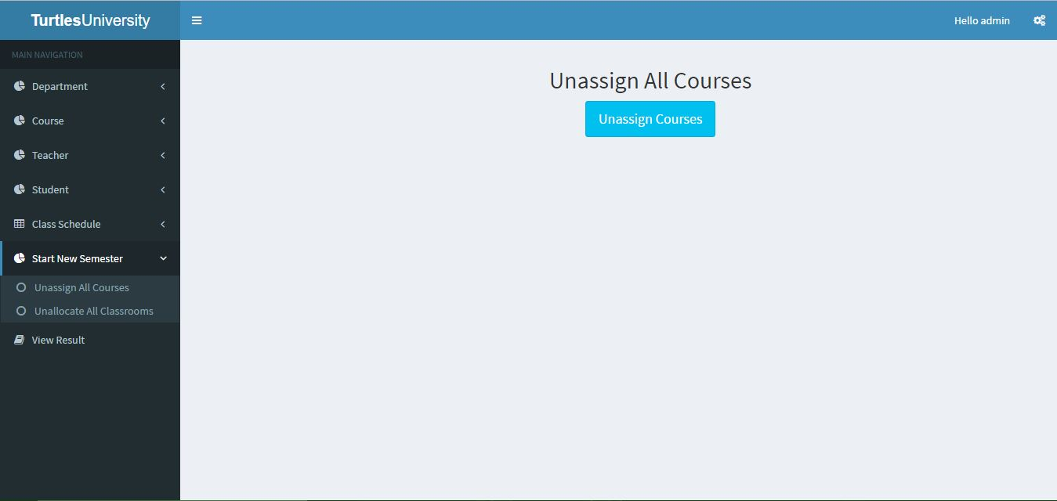
Unassign All Courses

Slide 40

Unallocate All Class Rooms

Slide 41
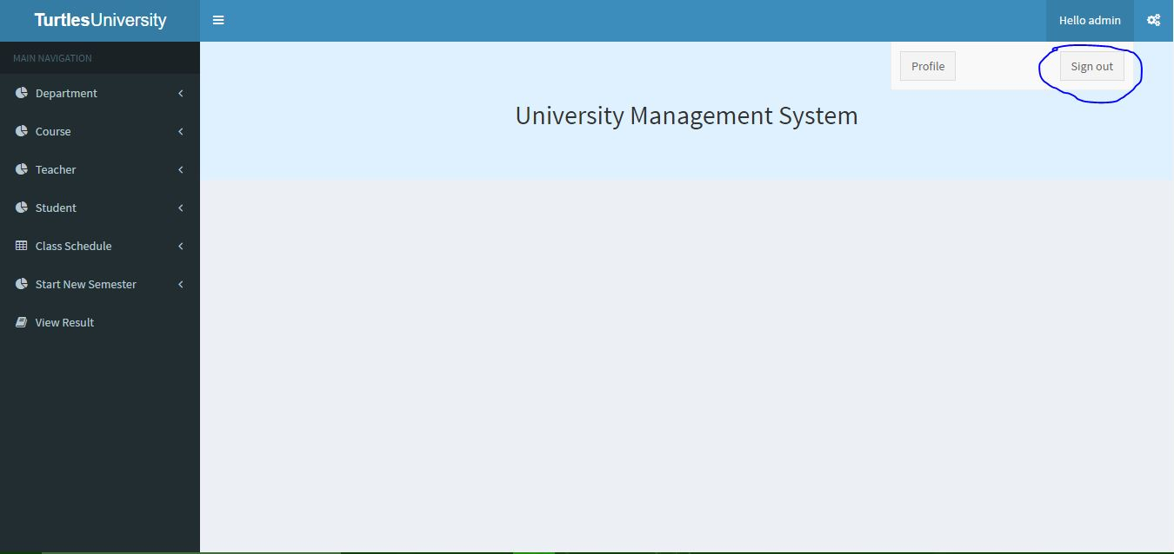
Sign out

Slide 42
Thank You!!
Thank you all

